Slide 1
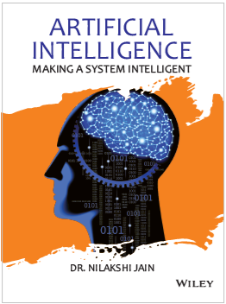
Chapter Ten
Representation Knowledge using rules

Slide 2
Learning objectives.
10.1 Propositional logic
10.1.1 What is logic?
10.1.2 Syntax
10.1.3 Semantics
10.1.4 Complex truth table
10.2 First-order logic
10.2.1 Syntax
10.2.2 Quantifiers
10.3 Inference in first order logic
10.4 Reasoning
10.5 Procedural Knowledge Vs Declarative Knowledge
10.6 Logic Programming
10.7 Matching
10.8 Control Knowledge
10.9 Forward and backward chaining (Type of reasoning)
After this chapter , students will be able to :
Understand the concept of propositional logic.
Apply logic on grammar.
Understand forward and backward channelling concept.
Copyright © 2019 by Wiley India Pvt. Ltd., 4436/7, Ansari Road, Daryaganj, New Delhi-110002

Slide 3
Propositional logic
10.1 Propositional logic
10.1.1 What is logic?
10.1.2 Syntax
10.1.3 Semantics
10.1.4 Complex truth table
10.2 First-order logic
10.2.1 Syntax
10.2.2 Quantifiers
10.3 Inference in first order logic
10.4 Reasoning
10.5 Procedural Knowledge Vs Declarative Knowledge
10.6 Logic Programming
10.7 Matching
10.8 Control Knowledge
10.9 Forward and backward chaining (Type of reasoning)
Propositional logic, additionally called string of words logic and statement logic, is that It is the branch of logic that studies ways in which change of integrity and/or modifying entire propositions, statements or sentences to make additional complicated propositions, statements or sentences, similarly because the logical relationships and properties that are derived from these strategies of mixing or sterilisation statements.
In propositional calculus, the best statements are thought about as indivisible by units.
What is logic?
Logic is concerned with reasoning and the validity of arguments. Generally, in logic, we are not concerned with the truth of statements, but their validity.
Copyright © 2019 by Wiley India Pvt. Ltd., 4436/7, Ansari Road, Daryaganj, New Delhi-110002

Slide 4
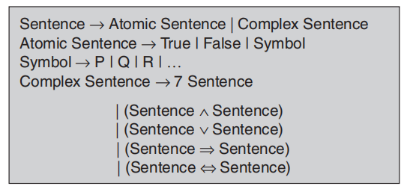
Syntax
10.1 Propositional logic
10.1.1 What is logic?
10.1.2 Syntax
10.1.3 Semantics
10.1.4 Complex truth table
10.2 First-order logic
10.2.1 Syntax
10.2.2 Quantifiers
10.3 Inference in first order logic
10.4 Reasoning
10.5 Procedural Knowledge Vs Declarative Knowledge
10.6 Logic Programming
10.7 Matching
10.8 Control Knowledge
10.9 Forward and backward chaining (Type of reasoning)
The syntax of propositional logic is simple. The symbols of propositional logic are the logical constants True and False, proposition symbols such as P and Q, the logical connectives ∨, ∧, →, ↔ and parentheses ().
Copyright © 2019 by Wiley India Pvt. Ltd., 4436/7, Ansari Road, Daryaganj, New Delhi-110002

Slide 5
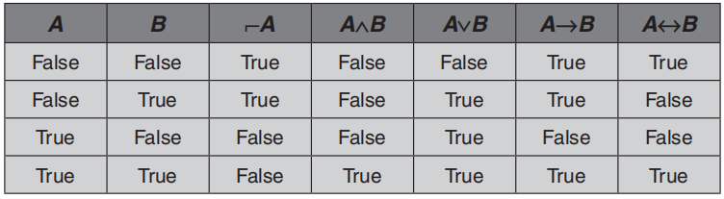
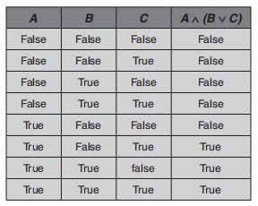
Semantic
10.1 Propositional logic
10.1.1 What is logic?
10.1.2 Syntax
10.1.3 Semantics
10.1.4 Complex truth table
10.2 First-order logic
10.2.1 Syntax
10.2.2 Quantifiers
10.3 Inference in first order logic
10.4 Reasoning
10.5 Procedural Knowledge Vs Declarative Knowledge
10.6 Logic Programming
10.7 Matching
10.8 Control Knowledge
10.9 Forward and backward chaining (Type of reasoning)
Complex truth table
Copyright © 2019 by Wiley India Pvt. Ltd., 4436/7, Ansari Road, Daryaganj, New Delhi-110002

Slide 6
First-order logic
10.1 Propositional logic
10.1.1 What is logic?
10.1.2 Syntax
10.1.3 Semantics
10.1.4 Complex truth table
10.2 First-order logic
10.2.1 Syntax
10.2.2 Quantifiers
10.3 Inference in first order logic
10.4 Reasoning
10.5 Procedural Knowledge Vs Declarative Knowledge
10.6 Logic Programming
10.7 Matching
10.8 Control Knowledge
10.9 Forward and backward chaining (Type of reasoning)
First-order logic is formal logical system used in mathematics, philosophy, linguistic and computer science.
First-order logic is distinguished from the propositional logic by its use of quantifiers; each interpretation of first-order logic includes a domain of discourse over which the quantifiers range.
Syntax
User defines these primitives as follows:
Constant symbols (i.e., the “individuals” in the world) egg: Ram, 4.
Function symbols (mapping individuals to individuals) egg: colour of (Ashoka Chakra) = Blue.
Predicate symbols (mapping from individuals to truth values) egg: greater (5,3), blue(sky).
Copyright © 2019 by Wiley India Pvt. Ltd., 4436/7, Ansari Road, Daryaganj, New Delhi-110002

Slide 7
First-order logic
10.1 Propositional logic
10.1.1 What is logic?
10.1.2 Syntax
10.1.3 Semantics
10.1.4 Complex truth table
10.2 First-order logic
10.2.1 Syntax
10.2.2 Quantifiers
10.3 Inference in first order logic
10.4 Reasoning
10.5 Procedural Knowledge Vs Declarative Knowledge
10.6 Logic Programming
10.7 Matching
10.8 Control Knowledge
10.9 Forward and backward chaining (Type of reasoning)
First-order logic supplies these primitives:
Variable symbols: egg x, y.
Connectives: ⌐, ∧, ∨, →, ↔
Quantifiers: universal and existential.
Quantifiers
Universal quantification corresponds to conjunction (and) in this (∀x) P(x) means that P holds for all values of x in the domain associated with that variable.
Existential quantification corresponds to disjunction (or) in that (∃x) P(x) means that P holds for some value of x in the domain associated with that variable.
Universal quantifiers are usually used with “implies” to form “IF–THEN rules”.
Copyright © 2019 by Wiley India Pvt. Ltd., 4436/7, Ansari Road, Daryaganj, New Delhi-110002

Slide 8
First-order logic
10.1 Propositional logic
10.1.1 What is logic?
10.1.2 Syntax
10.1.3 Semantics
10.1.4 Complex truth table
10.2 First-order logic
10.2.1 Syntax
10.2.2 Quantifiers
10.3 Inference in first order logic
10.4 Reasoning
10.5 Procedural Knowledge Vs Declarative Knowledge
10.6 Logic Programming
10.7 Matching
10.8 Control Knowledge
10.9 Forward and backward chaining (Type of reasoning)
4. Existential quantifiers are usually used with “and” to specify a list of properties or facts about an individual.
5. A common mistake is to represent this English sentence as the FOL sentence.
6. Switching the order of universal quantifiers does not change the meaning:
(∀x) (∀y) P (x, y) is logically equivalent to (∀y) (∀x) P (x, y). Similarly, the order of existential quantifiers can be switched.
7. Switching the order of universals and existential does change the meaning.
Copyright © 2019 by Wiley India Pvt. Ltd., 4436/7, Ansari Road, Daryaganj, New Delhi-110002

Slide 9
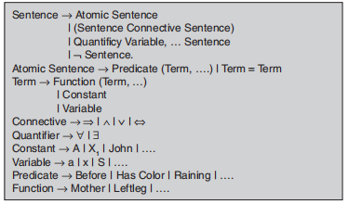
First-order logic
10.1 Propositional logic
10.1.1 What is logic?
10.1.2 Syntax
10.1.3 Semantics
10.1.4 Complex truth table
10.2 First-order logic
10.2.1 Syntax
10.2.2 Quantifiers
10.3 Inference in first order logic
10.4 Reasoning
10.5 Procedural Knowledge Vs Declarative Knowledge
10.6 Logic Programming
10.7 Matching
10.8 Control Knowledge
10.9 Forward and backward chaining (Type of reasoning)
Copyright © 2019 by Wiley India Pvt. Ltd., 4436/7, Ansari Road, Daryaganj, New Delhi-110002

Slide 10
Inference in first-order logic
10.1 Propositional logic
10.1.1 What is logic?
10.1.2 Syntax
10.1.3 Semantics
10.1.4 Complex truth table
10.2 First-order logic
10.2.1 Syntax
10.2.2 Quantifiers
10.3 Inference in first order logic
10.4 Reasoning
10.5 Procedural Knowledge Vs Declarative Knowledge
10.6 Logic Programming
10.7 Matching
10.8 Control Knowledge
10.9 Forward and backward chaining (Type of reasoning)
Universal elimination: if (∀x) P(x) is true, then P (c) is true, where c is a constant in the domain of x.
The variable symbol can be replaced by any ground term, i.e., any constant symbol or function symbol applied to ground terms only.
Existential introduction: If P(c) is true, then (∃x) P(x) is inferred.
All instance of the given constant symbols are replaced by the new variable symbol. Note that variable symbol cannot already exist anywhere in the expression.
Existential elimination: From (∃x) P(x) infer P(c).
Note that the variable is replaced by a brand new constant that does not occur in this or any other sentence in the knowledge base.
Copyright © 2019 by Wiley India Pvt. Ltd., 4436/7, Ansari Road, Daryaganj, New Delhi-110002

Slide 11
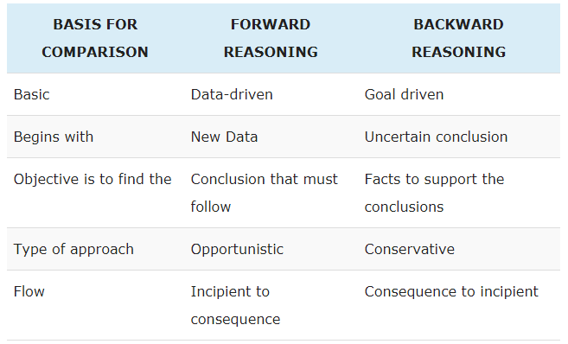
Reasoning
10.1 Propositional logic
10.1.1 What is logic?
10.1.2 Syntax
10.1.3 Semantics
10.1.4 Complex truth table
10.2 First-order logic
10.2.1 Syntax
10.2.2 Quantifiers
10.3 Inference in first order logic
10.4 Reasoning
10.5 Procedural Knowledge Vs Declarative Knowledge
10.6 Logic Programming
10.7 Matching
10.8 Control Knowledge
10.9 Forward and backward chaining (Type of reasoning)
The inference process that uses only rules for inference is termed as reasoning. Reasoning is also called as chaining. These are classified as: 1. Forward Reasoning
2. Backward Reasoning
Copyright © 2019 by Wiley India Pvt. Ltd., 4436/7, Ansari Road, Daryaganj, New Delhi-110002

Slide 12
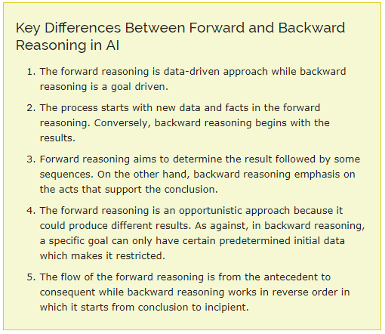
Reasoning
10.1 Propositional logic
10.1.1 What is logic?
10.1.2 Syntax
10.1.3 Semantics
10.1.4 Complex truth table
10.2 First-order logic
10.2.1 Syntax
10.2.2 Quantifiers
10.3 Inference in first order logic
10.4 Reasoning
10.5 Procedural Knowledge Vs Declarative Knowledge
10.6 Logic Programming
10.7 Matching
10.8 Control Knowledge
10.9 Forward and backward chaining (Type of reasoning)
Copyright © 2019 by Wiley India Pvt. Ltd., 4436/7, Ansari Road, Daryaganj, New Delhi-110002

Slide 13
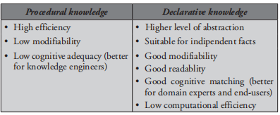
Procedural Knowledge Vs Declarative Knowledge
10.1 Propositional logic
10.1.1 What is logic?
10.1.2 Syntax
10.1.3 Semantics
10.1.4 Complex truth table
10.2 First-order logic
10.2.1 Syntax
10.2.2 Quantifiers
10.3 Inference in first order logic
10.4 Reasoning
10.5 Procedural Knowledge Vs Declarative Knowledge
10.6 Logic Programming
10.7 Matching
10.8 Control Knowledge
10.9 Forward and backward chaining (Type of reasoning)
Copyright © 2019 by Wiley India Pvt. Ltd., 4436/7, Ansari Road, Daryaganj, New Delhi-110002

Slide 14
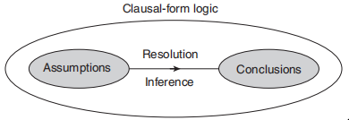
Logic programming
10.1 Propositional logic
10.1.1 What is logic?
10.1.2 Syntax
10.1.3 Semantics
10.1.4 Complex truth table
10.2 First-order logic
10.2.1 Syntax
10.2.2 Quantifiers
10.3 Inference in first order logic
10.4 Reasoning
10.5 Procedural Knowledge Vs Declarative Knowledge
10.6 Logic Programming
10.7 Matching
10.8 Control Knowledge
10.9 Forward and backward chaining (Type of reasoning)
Artificial intelligence is that the ability for a synthetic machine to act showing intelligence. Logic programming may be a technique that laptop scientists are exploitation to do to permit machines to reason as a result of it’s helpful for information illustration. In logic programming, logic is employed to represent information and logical thinking is employed to govern it.
Copyright © 2019 by Wiley India Pvt. Ltd., 4436/7, Ansari Road, Daryaganj, New Delhi-110002

Slide 15
Matching
10.1 Propositional logic
10.1.1 What is logic?
10.1.2 Syntax
10.1.3 Semantics
10.1.4 Complex truth table
10.2 First-order logic
10.2.1 Syntax
10.2.2 Quantifiers
10.3 Inference in first order logic
10.4 Reasoning
10.5 Procedural Knowledge Vs Declarative Knowledge
10.6 Logic Programming
10.7 Matching
10.8 Control Knowledge
10.9 Forward and backward chaining (Type of reasoning)
Matching is a process of comparing two or more structures to discover their difference or similarities. Matching is used to the best of a no of alternatives or retrieves items from a database or knowledgebase. Different matching processes are:
Indexing
Matching with variables
Complex and approximate matching
Conflict resolution
Copyright © 2019 by Wiley India Pvt. Ltd., 4436/7, Ansari Road, Daryaganj, New Delhi-110002

Slide 16
Control knowledge
10.1 Propositional logic
10.1.1 What is logic?
10.1.2 Syntax
10.1.3 Semantics
10.1.4 Complex truth table
10.2 First-order logic
10.2.1 Syntax
10.2.2 Quantifiers
10.3 Inference in first order logic
10.4 Reasoning
10.5 Procedural Knowledge Vs Declarative Knowledge
10.6 Logic Programming
10.7 Matching
10.8 Control Knowledge
10.9 Forward and backward chaining (Type of reasoning)
Knowledge about which paths are most likely to lead quickly to a goal state is often known as search control knowledge. It can take many forms.
Knowledge about which states are more preferable to others.
Knowledge about which rule to apply in the given situation.
Knowledge about the order in which to achieve subgoals.
Knowledge about useful sequence of rules to apply.
Control knowledge is also called as meta knowledge that is knowledge about knowledge. Two systems which represent control knowledge with rules are SOAR and PRODIGY.
Copyright © 2019 by Wiley India Pvt. Ltd., 4436/7, Ansari Road, Daryaganj, New Delhi-110002

Slide 17
Forward and backward chaining (Type of reasoning)
10.1 Propositional logic
10.1.1 What is logic?
10.1.2 Syntax
10.1.3 Semantics
10.1.4 Complex truth table
10.2 First-order logic
10.2.1 Syntax
10.2.2 Quantifiers
10.3 Inference in first order logic
10.4 Reasoning
10.5 Procedural Knowledge Vs Declarative Knowledge
10.6 Logic Programming
10.7 Matching
10.8 Control Knowledge
10.9 Forward and backward chaining (Type of reasoning)
The generalised modus ponens rule can be used in two ways. We can start with the sentences in the knowledge base and generate new conclusions which in turn allow more inferences to be made. This is called forward chaining.
Forward chaining is used generally when a new fact is added to database and we want to generate its consequences.
Alternatively, we can start with something we want to prove; find implication sentences that would allow us to conclude it, and attempt to establish their premises in turn. This is called backward chaining, because it uses modus ponens backwards.
Backward chaining is usually used when there is a goal to be proved.
Copyright © 2019 by Wiley India Pvt. Ltd., 4436/7, Ansari Road, Daryaganj, New Delhi-110002

Slide 18
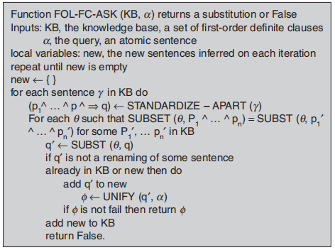
Forward and backward chaining (Type of reasoning)
10.1 Propositional logic
10.1.1 What is logic?
10.1.2 Syntax
10.1.3 Semantics
10.1.4 Complex truth table
10.2 First-order logic
10.2.1 Syntax
10.2.2 Quantifiers
10.3 Inference in first order logic
10.4 Reasoning
10.5 Procedural Knowledge Vs Declarative Knowledge
10.6 Logic Programming
10.7 Matching
10.8 Control Knowledge
10.9 Forward and backward chaining (Type of reasoning)
FORWARD CHAINING
ALGORITHM:
Copyright © 2019 by Wiley India Pvt. Ltd., 4436/7, Ansari Road, Daryaganj, New Delhi-110002

Slide 19
Forward and backward chaining (Type of reasoning)
10.1 Propositional logic
10.1.1 What is logic?
10.1.2 Syntax
10.1.3 Semantics
10.1.4 Complex truth table
10.2 First-order logic
10.2.1 Syntax
10.2.2 Quantifiers
10.3 Inference in first order logic
10.4 Reasoning
10.5 Procedural Knowledge Vs Declarative Knowledge
10.6 Logic Programming
10.7 Matching
10.8 Control Knowledge
10.9 Forward and backward chaining (Type of reasoning)
EXAMPLE:
KB = All cats like fish, cats eat everything they like and Ziggy is a cat. In FOL
KB = (∀x) cat (x) → likes (x, fish) (1)
(∀x) (∀x) (cat (x) ∧ likes (x, y)) → eats (x, y) (2)
Cat (Ziggy) (3)
Goal query: Does Ziggy eat fish?
Proof: Use GMP with Eqs. (1) and (3) to derive Eq. (4): likes (Ziggy, fish)
Use GMP with Eqs. (3), (4) and (2) to derive: eats (Ziggy, fish) (4)
So, yes, Ziggy eats fish.
Copyright © 2019 by Wiley India Pvt. Ltd., 4436/7, Ansari Road, Daryaganj, New Delhi-110002

Slide 20
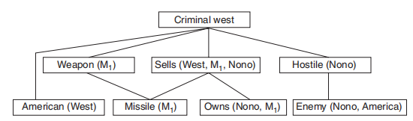
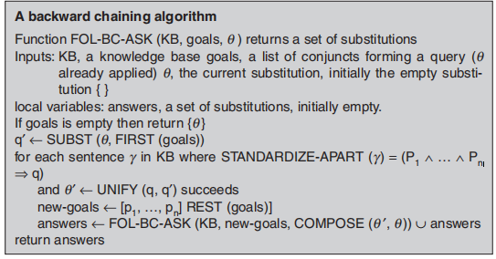
Forward and backward chaining (Type of reasoning)
10.1 Propositional logic
10.1.1 What is logic?
10.1.2 Syntax
10.1.3 Semantics
10.1.4 Complex truth table
10.2 First-order logic
10.2.1 Syntax
10.2.2 Quantifiers
10.3 Inference in first order logic
10.4 Reasoning
10.5 Procedural Knowledge Vs Declarative Knowledge
10.6 Logic Programming
10.7 Matching
10.8 Control Knowledge
10.9 Forward and backward chaining (Type of reasoning)
BACKWARD
ALGORITHM:
Copyright © 2019 by Wiley India Pvt. Ltd., 4436/7, Ansari Road, Daryaganj, New Delhi-110002

Slide 21
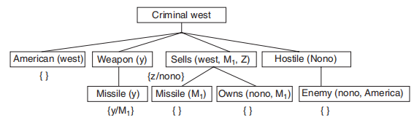
Forward and backward chaining (Type of reasoning)
10.1 Propositional logic
10.1.1 What is logic?
10.1.2 Syntax
10.1.3 Semantics
10.1.4 Complex truth table
10.2 First-order logic
10.2.1 Syntax
10.2.2 Quantifiers
10.3 Inference in first order logic
10.4 Reasoning
10.5 Procedural Knowledge Vs Declarative Knowledge
10.6 Logic Programming
10.7 Matching
10.8 Control Knowledge
10.9 Forward and backward chaining (Type of reasoning)
EXAMPLE:
Does Ziggy eat fish?
Proof: Goal Driven
(∀x) (cat(x)) → likes (x, fish)
(∀x) (∀y) (cat (x) ∧ likes(x, y)) → eats(x, y)
Cat(Ziggy)
Copyright © 2019 by Wiley India Pvt. Ltd., 4436/7, Ansari Road, Daryaganj, New Delhi-110002

Slide 22
Forward Chaining
10.1 Propositional logic
10.1.1 What is logic?
10.1.2 Syntax
10.1.3 Semantics
10.1.4 Complex truth table
10.2 First-order logic
10.2.1 Syntax
10.2.2 Quantifiers
10.3 Inference in first order logic
10.4 Reasoning
10.5 Procedural Knowledge Vs Declarative Knowledge
10.6 Logic Programming
10.7 Matching
10.8 Control Knowledge
10.9 Forward and backward chaining (Type of reasoning)
Forward chaining is a data driven method of deriving a particular goal from a given knowledge base and set of inference rules
Inference rules are applied by matching facts to the antecedents of consequence relations in the knowledge base
The application of inference rules results in new knowledge (from the consequents of the relations matched), which is then added to the knowledge base
Copyright © 2019 by Wiley India Pvt. Ltd., 4436/7, Ansari Road, Daryaganj, New Delhi-110002

Slide 23
Forward Chaining
10.1 Propositional logic
10.1.1 What is logic?
10.1.2 Syntax
10.1.3 Semantics
10.1.4 Complex truth table
10.2 First-order logic
10.2.1 Syntax
10.2.2 Quantifiers
10.3 Inference in first order logic
10.4 Reasoning
10.5 Procedural Knowledge Vs Declarative Knowledge
10.6 Logic Programming
10.7 Matching
10.8 Control Knowledge
10.9 Forward and backward chaining (Type of reasoning)
Inference rules are successively applied to elements of the knowledge base until the goal is reached
A search control method is needed to select which element(s) of the knowledge base to apply the inference rule to at any point in the deduction
Copyright © 2019 by Wiley India Pvt. Ltd., 4436/7, Ansari Road, Daryaganj, New Delhi-110002

Slide 24
Forward Chaining Example
10.1 Propositional logic
10.1.1 What is logic?
10.1.2 Syntax
10.1.3 Semantics
10.1.4 Complex truth table
10.2 First-order logic
10.2.1 Syntax
10.2.2 Quantifiers
10.3 Inference in first order logic
10.4 Reasoning
10.5 Procedural Knowledge Vs Declarative Knowledge
10.6 Logic Programming
10.7 Matching
10.8 Control Knowledge
10.9 Forward and backward chaining (Type of reasoning)
Knowledge Base:
If [X croaks and eats flies] Then [X is a frog]
If [X chirps and sings] Then [X is a canary]
If [X is a frog] Then [X is colored green]
If [X is a canary] Then [X is colored yellow]
[Fritz croaks and eats flies]
Goal:
[Fritz is colored Y]?
Copyright © 2019 by Wiley India Pvt. Ltd., 4436/7, Ansari Road, Daryaganj, New Delhi-110002

Slide 25
Forward Chaining Example
10.1 Propositional logic
10.1.1 What is logic?
10.1.2 Syntax
10.1.3 Semantics
10.1.4 Complex truth table
10.2 First-order logic
10.2.1 Syntax
10.2.2 Quantifiers
10.3 Inference in first order logic
10.4 Reasoning
10.5 Procedural Knowledge Vs Declarative Knowledge
10.6 Logic Programming
10.7 Matching
10.8 Control Knowledge
10.9 Forward and backward chaining (Type of reasoning)
Knowledge Base
If [X croaks and eats flies]
Then [X is a frog]
If [X chirps and sings]
Then [X is a canary]
If [X is a frog]
Then [X is colored green]
If [X is a canary]
Then [X is colored yellow]
[Fritz croaks and eats flies]
Goal
[Fritz is colored Y]?
Copyright © 2019 by Wiley India Pvt. Ltd., 4436/7, Ansari Road, Daryaganj, New Delhi-110002

Slide 26
Forward Chaining Example
10.1 Propositional logic
10.1.1 What is logic?
10.1.2 Syntax
10.1.3 Semantics
10.1.4 Complex truth table
10.2 First-order logic
10.2.1 Syntax
10.2.2 Quantifiers
10.3 Inference in first order logic
10.4 Reasoning
10.5 Procedural Knowledge Vs Declarative Knowledge
10.6 Logic Programming
10.7 Matching
10.8 Control Knowledge
10.9 Forward and backward chaining (Type of reasoning)
Knowledge Base
If [X croaks and eats flies]
Then [X is a frog]
If [X chirps and sings]
Then [X is a canary]
If [X is a frog]
Then [X is colored green]
If [X is a canary]
Then [X is colored yellow]
[Fritz croaks and eats flies]
Goal
[Fritz is colored Y]?
Copyright © 2019 by Wiley India Pvt. Ltd., 4436/7, Ansari Road, Daryaganj, New Delhi-110002

Slide 27
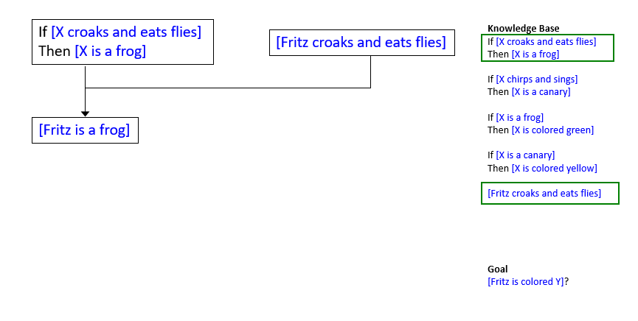
Forward Chaining Example
10.1 Propositional logic
10.1.1 What is logic?
10.1.2 Syntax
10.1.3 Semantics
10.1.4 Complex truth table
10.2 First-order logic
10.2.1 Syntax
10.2.2 Quantifiers
10.3 Inference in first order logic
10.4 Reasoning
10.5 Procedural Knowledge Vs Declarative Knowledge
10.6 Logic Programming
10.7 Matching
10.8 Control Knowledge
10.9 Forward and backward chaining (Type of reasoning)
Copyright © 2019 by Wiley India Pvt. Ltd., 4436/7, Ansari Road, Daryaganj, New Delhi-110002

Slide 28
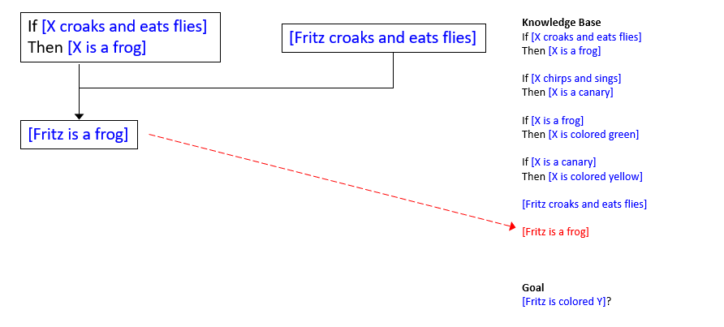
Forward Chaining Example
10.1 Propositional logic
10.1.1 What is logic?
10.1.2 Syntax
10.1.3 Semantics
10.1.4 Complex truth table
10.2 First-order logic
10.2.1 Syntax
10.2.2 Quantifiers
10.3 Inference in first order logic
10.4 Reasoning
10.5 Procedural Knowledge Vs Declarative Knowledge
10.6 Logic Programming
10.7 Matching
10.8 Control Knowledge
10.9 Forward and backward chaining (Type of reasoning)
Copyright © 2019 by Wiley India Pvt. Ltd., 4436/7, Ansari Road, Daryaganj, New Delhi-110002

Slide 29
Forward Chaining Example
If [X croaks and eats flies]
Then [X is a frog]
Knowledge Base
If [X croaks and eats flies]
Then [X is a frog]
If [X chirps and sings]
Then [X is a canary]
If [X is a frog]
Then [X is colored green]
If [X is a canary]
Then [X is colored yellow]
[Fritz croaks and eats flies]
[Fritz is a frog]
Goal
[Fritz is colored Y]?
[Fritz croaks and eats flies]
[Fritz is a frog]
?
Copyright © 2019 by Wiley India Pvt. Ltd., 4436/7, Ansari Road, Daryaganj, New Delhi-110002

Slide 30
Forward Chaining Example
If [X croaks and eats flies]
Then [X is a frog]
Knowledge Base
If [X croaks and eats flies]
Then [X is a frog]
If [X chirps and sings]
Then [X is a canary]
If [X is a frog]
Then [X is colored green]
If [X is a canary]
Then [X is colored yellow]
[Fritz croaks and eats flies]
[Fritz is a frog]
Goal
[Fritz is colored Y]?
[Fritz croaks and eats flies]
[Fritz is a frog]
Copyright © 2019 by Wiley India Pvt. Ltd., 4436/7, Ansari Road, Daryaganj, New Delhi-110002

Slide 31
Forward Chaining Example
If [X croaks and eats flies]
Then [X is a frog]
Knowledge Base
If [X croaks and eats flies]
Then [X is a frog]
If [X chirps and sings]
Then [X is a canary]
If [X is a frog]
Then [X is colored green]
If [X is a canary]
Then [X is colored yellow]
[Fritz croaks and eats flies]
[Fritz is a frog]
Goal
[Fritz is colored Y]?
[Fritz croaks and eats flies]
If [X is a frog]
Then [X is colored green]
[Fritz is a frog]
[Fritz is colored green]
Copyright © 2019 by Wiley India Pvt. Ltd., 4436/7, Ansari Road, Daryaganj, New Delhi-110002

Slide 32
Forward Chaining Example
If [X croaks and eats flies]
Then [X is a frog]
Knowledge Base
If [X croaks and eats flies]
Then [X is a frog]
If [X chirps and sings]
Then [X is a canary]
If [X is a frog]
Then [X is colored green]
If [X is a canary]
Then [X is colored yellow]
[Fritz croaks and eats flies]
[Fritz is a frog]
[Fritz is colored green]
Goal
[Fritz is colored Y]?
[Fritz croaks and eats flies]
If [X is a frog]
Then [X is colored green]
[Fritz is a frog]
[Fritz is colored green]
Copyright © 2019 by Wiley India Pvt. Ltd., 4436/7, Ansari Road, Daryaganj, New Delhi-110002

Slide 33
Forward Chaining Example
If [X croaks and eats flies]
Then [X is a frog]
Knowledge Base
If [X croaks and eats flies]
Then [X is a frog]
If [X chirps and sings]
Then [X is a canary]
If [X is a frog]
Then [X is colored green]
If [X is a canary]
Then [X is colored yellow]
[Fritz croaks and eats flies]
[Fritz is a frog]
[Fritz is colored green]
Goal
[Fritz is colored Y]?
[Fritz croaks and eats flies]
If [X is a frog]
Then [X is colored green]
[Fritz is a frog]
[Fritz is colored green]
?
Copyright © 2019 by Wiley India Pvt. Ltd., 4436/7, Ansari Road, Daryaganj, New Delhi-110002

Slide 34
Forward Chaining Example
If [X croaks and eats flies]
Then [X is a frog]
Knowledge Base
If [X croaks and eats flies]
Then [X is a frog]
If [X chirps and sings]
Then [X is a canary]
If [X is a frog]
Then [X is colored green]
If [X is a canary]
Then [X is colored yellow]
[Fritz croaks and eats flies]
[Fritz is a frog]
[Fritz is colored green]
Goal
[Fritz is colored Y]?
[Fritz croaks and eats flies]
If [X is a frog]
Then [X is colored green]
[Fritz is a frog]
[Fritz is colored green]
Copyright © 2019 by Wiley India Pvt. Ltd., 4436/7, Ansari Road, Daryaganj, New Delhi-110002

Slide 35
Forward Chaining Example
If [X croaks and eats flies]
Then [X is a frog]
Knowledge Base
If [X croaks and eats flies]
Then [X is a frog]
If [X chirps and sings]
Then [X is a canary]
If [X is a frog]
Then [X is colored green]
If [X is a canary]
Then [X is colored yellow]
[Fritz croaks and eats flies]
[Fritz is a frog]
[Fritz is colored green]
Goal
[Fritz is colored Y]?
[Fritz croaks and eats flies]
If [X is a frog]
Then [X is colored green]
[Fritz is a frog]
[Fritz is colored green]
[Fritz is colored Y] ?
Y = green
Copyright © 2019 by Wiley India Pvt. Ltd., 4436/7, Ansari Road, Daryaganj, New Delhi-110002

Slide 36
Backward Chaining
10.1 Propositional logic
10.1.1 What is logic?
10.1.2 Syntax
10.1.3 Semantics
10.1.4 Complex truth table
10.2 First-order logic
10.2.1 Syntax
10.2.2 Quantifiers
10.3 Inference in first order logic
10.4 Reasoning
10.5 Procedural Knowledge Vs Declarative Knowledge
10.6 Logic Programming
10.7 Matching
10.8 Control Knowledge
10.9 Forward and backward chaining (Type of reasoning)
Backward chaining is a goal driven method of deriving a particular goal from a given knowledge base and set of inference rules
Inference rules are applied by matching the goal of the search to the consequents of the relations stored in the knowledge base
When such a relation is found, the antecedent of the relation is added to the list of goals (and not into the knowledge base, as is done in forward chaining)
Copyright © 2019 by Wiley India Pvt. Ltd., 4436/7, Ansari Road, Daryaganj, New Delhi-110002

Slide 37
Backward Chaining
10.1 Propositional logic
10.1.1 What is logic?
10.1.2 Syntax
10.1.3 Semantics
10.1.4 Complex truth table
10.2 First-order logic
10.2.1 Syntax
10.2.2 Quantifiers
10.3 Inference in first order logic
10.4 Reasoning
10.5 Procedural Knowledge Vs Declarative Knowledge
10.6 Logic Programming
10.7 Matching
10.8 Control Knowledge
10.9 Forward and backward chaining (Type of reasoning)
Search proceeds in this manner until a goal can be matched against a fact in the knowledge base
Remember: facts are simply consequence relations with empty antecedents, so this is like adding the ‘empty goal’ to the list of goals
As with forward chaining, a search control method is needed to select which goals will be matched against which consequence relations from the knowledge base
Copyright © 2019 by Wiley India Pvt. Ltd., 4436/7, Ansari Road, Daryaganj, New Delhi-110002

Slide 38
Backward Chaining Example
10.1 Propositional logic
10.1.1 What is logic?
10.1.2 Syntax
10.1.3 Semantics
10.1.4 Complex truth table
10.2 First-order logic
10.2.1 Syntax
10.2.2 Quantifiers
10.3 Inference in first order logic
10.4 Reasoning
10.5 Procedural Knowledge Vs Declarative Knowledge
10.6 Logic Programming
10.7 Matching
10.8 Control Knowledge
10.9 Forward and backward chaining (Type of reasoning)
Knowledge Base
If [X croaks and eats flies]
Then [X is a frog]
If [X chirps and sings]
Then [X is a canary]
If [X is a frog]
Then [X is colored green]
If [X is a canary]
Then [X is colored yellow]
[Fritz croaks and eats flies]
Goals
[Fritz is colored Y]?
Copyright © 2019 by Wiley India Pvt. Ltd., 4436/7, Ansari Road, Daryaganj, New Delhi-110002

Slide 39
Backward Chaining Example
10.1 Propositional logic
10.1.1 What is logic?
10.1.2 Syntax
10.1.3 Semantics
10.1.4 Complex truth table
10.2 First-order logic
10.2.1 Syntax
10.2.2 Quantifiers
10.3 Inference in first order logic
10.4 Reasoning
10.5 Procedural Knowledge Vs Declarative Knowledge
10.6 Logic Programming
10.7 Matching
10.8 Control Knowledge
10.9 Forward and backward chaining (Type of reasoning)
Knowledge Base
If [X croaks and eats flies]
Then [X is a frog]
If [X chirps and sings]
Then [X is a canary]
If [X is a frog]
Then [X is colored green]
If [X is a canary]
Then [X is colored yellow]
[Fritz croaks and eats flies]
Goals
[Fritz is colored Y]?
Copyright © 2019 by Wiley India Pvt. Ltd., 4436/7, Ansari Road, Daryaganj, New Delhi-110002

Slide 40
Backward Chaining Example
[Fritz is colored Y]
Knowledge Base
If [X croaks and eats flies]
Then [X is a frog]
If [X chirps and sings]
Then [X is a canary]
If [X is a frog]
Then [X is colored green]
If [X is a canary]
Then [X is colored yellow]
[Fritz croaks and eats flies]
Goals
[Fritz is colored Y]?
If [X is a frog]
Then [X is colored green]
[X is a frog]
Copyright © 2019 by Wiley India Pvt. Ltd., 4436/7, Ansari Road, Daryaganj, New Delhi-110002

Slide 41
Backward Chaining Example
[Fritz is colored Y]
Knowledge Base
If [X croaks and eats flies]
Then [X is a frog]
If [X chirps and sings]
Then [X is a canary]
If [X is a frog]
Then [X is colored green]
If [X is a canary]
Then [X is colored yellow]
[Fritz croaks and eats flies]
Goals
[Fritz is colored Y]?
[X is a frog]
If [X is a frog]
Then [X is colored green]
[X is a frog]
Copyright © 2019 by Wiley India Pvt. Ltd., 4436/7, Ansari Road, Daryaganj, New Delhi-110002

Slide 42
Backward Chaining Example
[Fritz is colored Y]
Knowledge Base
If [X croaks and eats flies]
Then [X is a frog]
If [X chirps and sings]
Then [X is a canary]
If [X is a frog]
Then [X is colored green]
If [X is a canary]
Then [X is colored yellow]
[Fritz croaks and eats flies]
Goals
[Fritz is colored Y]?
[X is a frog]
If [X is a frog]
Then [X is colored green]
[X is a frog]
Copyright © 2019 by Wiley India Pvt. Ltd., 4436/7, Ansari Road, Daryaganj, New Delhi-110002

Slide 43
Backward Chaining Example
[Fritz is colored Y]
Knowledge Base
If [X croaks and eats flies]
Then [X is a frog]
If [X chirps and sings]
Then [X is a canary]
If [X is a frog]
Then [X is colored green]
If [X is a canary]
Then [X is colored yellow]
[Fritz croaks and eats flies]
Goals
[Fritz is colored Y]?
[X is a frog]
If [X is a frog]
Then [X is colored green]
If [X is a canary]
Then [X is colored yellow]
[X is a frog]
[X is a canary]
Copyright © 2019 by Wiley India Pvt. Ltd., 4436/7, Ansari Road, Daryaganj, New Delhi-110002

Slide 44
Backward Chaining Example
[Fritz is colored Y]
Knowledge Base
If [X croaks and eats flies]
Then [X is a frog]
If [X chirps and sings]
Then [X is a canary]
If [X is a frog]
Then [X is colored green]
If [X is a canary]
Then [X is colored yellow]
[Fritz croaks and eats flies]
Goals
[Fritz is colored Y]?
[X is a frog]
[X is a canary]
If [X is a frog]
Then [X is colored green]
If [X is a canary]
Then [X is colored yellow]
[X is a frog]
[X is a canary]
Copyright © 2019 by Wiley India Pvt. Ltd., 4436/7, Ansari Road, Daryaganj, New Delhi-110002

Slide 45
Backward Chaining Example
[Fritz is colored Y]
Knowledge Base
If [X croaks and eats flies]
Then [X is a frog]
If [X chirps and sings]
Then [X is a canary]
If [X is a frog]
Then [X is colored green]
If [X is a canary]
Then [X is colored yellow]
[Fritz croaks and eats flies]
Goals
[Fritz is colored Y]?
[X is a frog]
[X is a canary]
If [X is a frog]
Then [X is colored green]
If [X is a canary]
Then [X is colored yellow]
[X is a frog]
[X is a canary]
Copyright © 2019 by Wiley India Pvt. Ltd., 4436/7, Ansari Road, Daryaganj, New Delhi-110002

Slide 46
Backward Chaining Example
[Fritz is colored Y]
Knowledge Base
If [X croaks and eats flies]
Then [X is a frog]
If [X chirps and sings]
Then [X is a canary]
If [X is a frog]
Then [X is colored green]
If [X is a canary]
Then [X is colored yellow]
[Fritz croaks and eats flies]
Goals
[Fritz is colored Y]?
[X is a frog]
[X is a canary]
If [X is a frog]
Then [X is colored green]
If [X is a canary]
Then [X is colored yellow]
[X is a frog]
[X is a canary]
If [X croaks and eats flies]
Then [X is a frog]
[X croaks and eats flies]
Copyright © 2019 by Wiley India Pvt. Ltd., 4436/7, Ansari Road, Daryaganj, New Delhi-110002

Slide 47
Backward Chaining Example
[Fritz is colored Y]
Knowledge Base
If [X croaks and eats flies]
Then [X is a frog]
If [X chirps and sings]
Then [X is a canary]
If [X is a frog]
Then [X is colored green]
If [X is a canary]
Then [X is colored yellow]
[Fritz croaks and eats flies]
Goals
[Fritz is colored Y]?
[X is a frog]
[X is a canary]
[X croaks and eats flies]
If [X is a frog]
Then [X is colored green]
If [X is a canary]
Then [X is colored yellow]
[X is a frog]
[X is a canary]
If [X croaks and eats flies]
Then [X is a frog]
[X croaks and eats flies]
Copyright © 2019 by Wiley India Pvt. Ltd., 4436/7, Ansari Road, Daryaganj, New Delhi-110002

Slide 48
Backward Chaining Example
[Fritz is colored Y]
Knowledge Base
If [X croaks and eats flies]
Then [X is a frog]
If [X chirps and sings]
Then [X is a canary]
If [X is a frog]
Then [X is colored green]
If [X is a canary]
Then [X is colored yellow]
[Fritz croaks and eats flies]
Goals
[Fritz is colored Y]?
[X is a frog]
[X is a canary]
[X croaks and eats flies]
If [X is a frog]
Then [X is colored green]
If [X is a canary]
Then [X is colored yellow]
[X is a frog]
[X is a canary]
If [X croaks and eats flies]
Then [X is a frog]
[X croaks and eats flies]
Copyright © 2019 by Wiley India Pvt. Ltd., 4436/7, Ansari Road, Daryaganj, New Delhi-110002

Slide 49
Backward Chaining Example
[Fritz is colored Y]
Knowledge Base
If [X croaks and eats flies]
Then [X is a frog]
If [X chirps and sings]
Then [X is a canary]
If [X is a frog]
Then [X is colored green]
If [X is a canary]
Then [X is colored yellow]
[Fritz croaks and eats flies]
Goals
[Fritz is colored Y]?
[X is a frog]
[X is a canary]
[X croaks and eats flies]
If [X is a frog]
Then [X is colored green]
If [X is a canary]
Then [X is colored yellow]
[X is a frog]
[X is a canary]
If [X croaks and eats flies]
Then [X is a frog]
[X croaks and eats flies]
[Fritz croaks and eats flies]
X = Fritz, Y = green
Copyright © 2019 by Wiley India Pvt. Ltd., 4436/7, Ansari Road, Daryaganj, New Delhi-110002

Slide 50
Backward Chaining Example
[Fritz is colored Y]
Knowledge Base
If [X croaks and eats flies]
Then [X is a frog]
If [X chirps and sings]
Then [X is a canary]
If [X is a frog]
Then [X is colored green]
If [X is a canary]
Then [X is colored yellow]
[Fritz croaks and eats flies]
Goals
[Fritz is colored Y]?
[X is a frog]
[X is a canary]
[X croaks and eats flies]
If [X is a frog]
Then [X is colored green]
If [X is a canary]
Then [X is colored yellow]
[X is a frog]
[X is a canary]
If [X croaks and eats flies]
Then [X is a frog]
[X croaks and eats flies]
[Fritz croaks and eats flies]
X = Fritz, Y = green
Copyright © 2019 by Wiley India Pvt. Ltd., 4436/7, Ansari Road, Daryaganj, New Delhi-110002

Slide 51
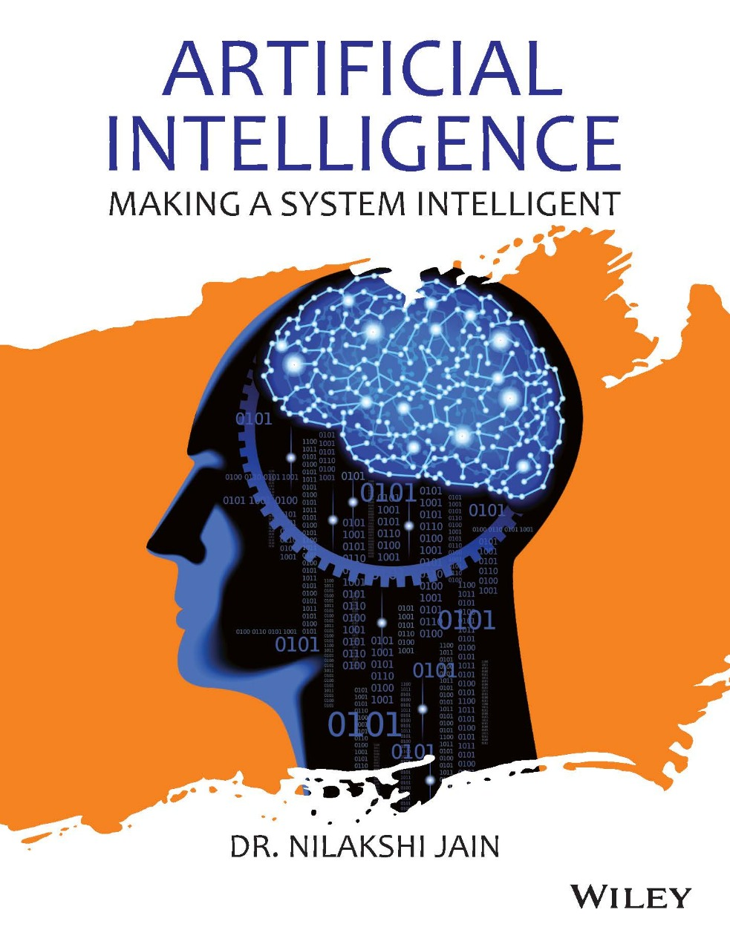
Dr. Nilakshi Jain Email ID : nilakshijain1986@gmail.com
Thank you

